Slide 1
Writing Reports, Proposals, and Technical Documents
  By Laurie A. Pinkert
Notes:
Rationale: Welcome to “Writing Reports, Proposals, and Technical Documents.” This presentation is designed to introduce students to writing reports, proposals, and technical documents.
This presentation may be supplemented with the following OWL resources:
- http://owl.english.purdue.edu/owl/section/4/16/
Directions: Each slide is activated by a single mouse click, unless otherwise noted in bold at the bottom of each notes page
Writer and Designer: Laurie A. Pinkert
Contributors: Laurie A. Pinkert
Revising Author: Elizabeth L. Angeli, 7 May 2012
Developed with resources courtesy of the Purdue University Writing Lab
© Copyright Purdue University, 2000, 2006, 2008, 2012

Slide 2
Presentation Overview
Genres and constraints
Scientific style
  Document design
  Textual features
Writing and revision
  Principles
  An exercise

Slide 3
Genres and Constraints
Reports
Proposals
Other technical documents (abstracts, etc.)
Notes:
Activity: Identify audience, purpose, and constraints for various genres listed above.
Discussion the way that these elements of the (rhetorical) situation influence the specifics that we’re going to review in the remaining slides. Sometimes one element --- conforming to a company standard or journal’s citation style will overrule another elements that are a part of scientific style.

Slide 4
What is Style?
Document design
  Formatting standards
Rules or guidelines
  Writing principles
Notes:
Style can be used to discuss not only textual features but also design elements. In such cases style refers to standards for formatting and writing. As previously noted style isn’t always fixed. Rather, it is flexible; thus, these suggestions might be understood as principles to guide writing decisions rather than rules that will work in every situation.

Slide 5
Disciplinary Differences
  Best Practices in the Humanities:
  Flexible conventions for structure depending on the task; transitions, rather than headings, are commonly used to demarcate major sections of writing
  Reliance of text rather than visual elements to convey main ideas
  Transitions generally signify changes in or two emphasize particular aspects of the author’s position (“therefore,” “furthermore,” in any case”)
  Use MLA or other appropriate humanities styles to cite sources
  Best Practices in the Sciences:
  Strict adherence to structural genre conventions, such as the abstract, introduction, methods, results, references
  Use multiple visual elements, such as charts or graphs, to demonstrate important concepts
  Clear procedural transitions that signal particular steps in an experiment (e.g., first, second, third)
  Use of a discipline-appropriate scientific style of citation
Notes:
Style can be used to discuss not only textual features but also design elements. In such cases style refers to standards for formatting and writing. As previously noted style isn’t always fixed. Rather, it is flexible; thus, these suggestions might be understood as principles to guide writing decisions rather than rules that will work in every situation.

Slide 6
Document Design
Headers
  Use distinguishable features (e.g., bold, all caps, larger font, etc.)
Spacing between sections
  Should be consistent
Each textual unit should use the same font and size
  Headers should all be the same font and size
  Body text should all be the same font and size
    These sections may differ from one another

Slide 7
Document Design
Tables and charts should be
  All the same size
  Labeled consistently
  Scaled appropriately
  Embedded in text or located in an appendix
  Placed immediately after the paragraph that first refers to it
  Referred to in text

Slide 8
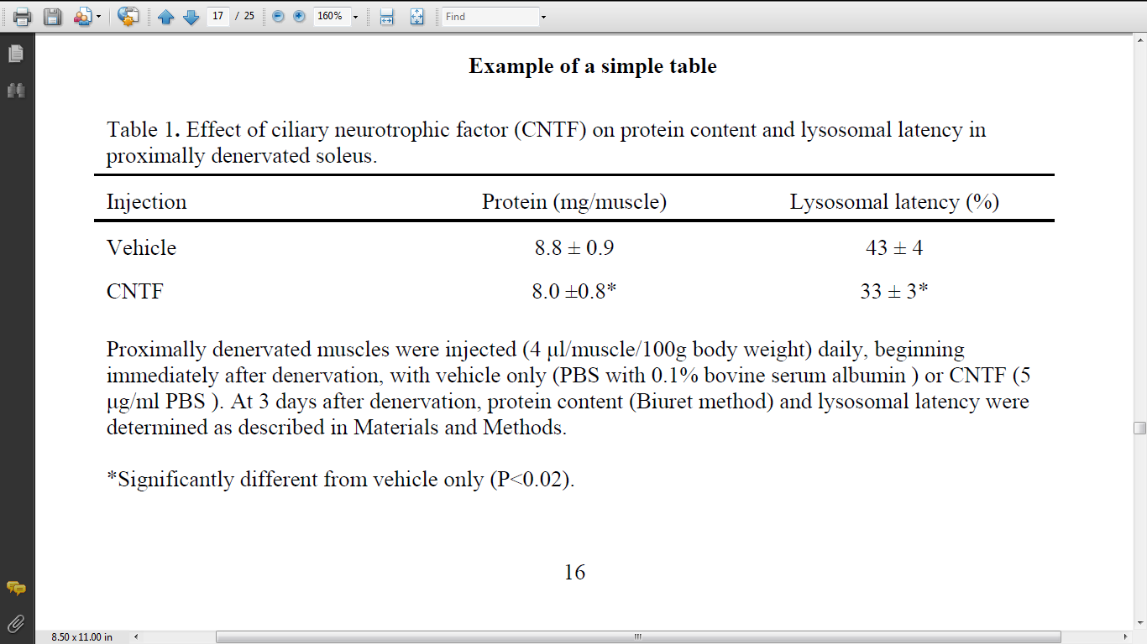
Simple Table
* Sample from p. 16 <http://www.biochem.arizona.edu/marc/Sci-Writing.pdf>

Slide 9
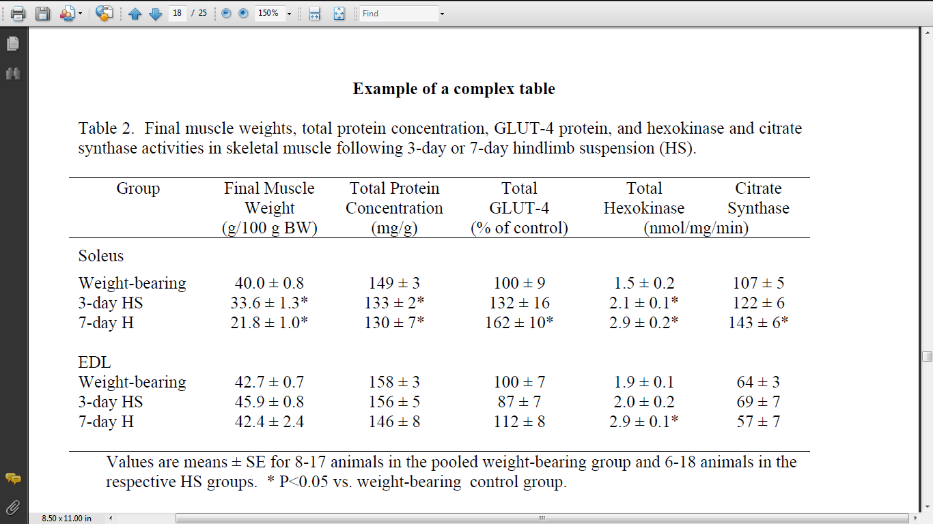
Complex Table
* Sample from p. 18 <http://www.biochem.arizona.edu/marc/Sci-Writing.pdf>

Slide 10
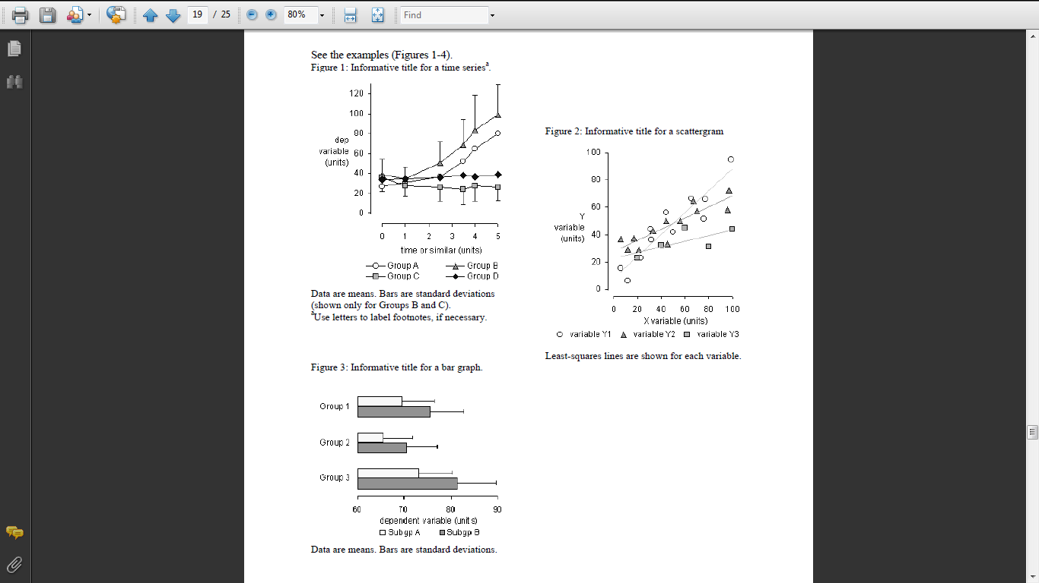
Figures
* Sample from p. 19 <http://www.biochem.arizona.edu/marc/Sci-Writing.pdf>

Slide 11
Principles for Writing Clearly
1. Open your sentences with short concrete subjects that name the characters.
2. Use specific verbs to name their important actions.
3. Get to the main verb quickly.
4. Open your sentences with information familiar to reader.
5. Push new, complex units of information to the end of the sentence.
6. Begin sentences constituting a passage with consistent topic/ subjects.
7. Be concise.
8. Control sprawl.
9. Use parallel structures.
10. Above all, write to others as you have others write to you.
* Principles from Joseph Williams’s (2012) Style: The Basics of Clarity and Grace
Notes:
Discuss these briefly --- point out 2, 4, 6, and 7 as relevant to scientific style.

Slide 12
#4 - Start with Familiar Information
  By starting with the familiar, you should be able to make connections between your findings and your conclusions
    TRY: After identifying the lethal allele, we modified our selections in the next round.
    Not: The lethal allele changed my strategy.
Notes:
This is principle 4 from Williams list – start with familiar information. In scientific writing, this principle can help us make connections between our finding and our conclusions.

Slide 13
Language to Create Connections
Addition
  “Furthermore,” “In addition,” “Moreover”
Elaboration
  “By extension,” “In short,” “In other words”
Example
  “For instance,” “For example,” “As an illustration”
Comparison
  “Likewise,” “Similarly”
Cause and effect
  “Accordingly,” “Consequently,” “Hence,” “As a result”
Notes:
Connect these examples to the chart on disciplinary differences: Clear procedural transitions that signal particular steps in an experiment (e.g. first, second, third)‏
Ask for additional transitional language that is often used

Slide 14
#7 – Be Concise but Clear
Use plain language
  Scientific reports are fairly straightforward, so avoid metaphors, similes, allusions, etc.
    TRY: The selections in round two were informed by my prior experience.
    NOT: Making selections was easy as pie.

Slide 15
#6 - Begin with Consistent Subjects
Topics are crucial for readers because readers depend on topics to focus their attention on particular ideas toward the beginning of sentences. Topics tell readers what a whole passage is "about." If readers feel that a sequence of topics is coherent, then they will feel they are moving through a paragraph from a cumulatively coherent point of view. But if throughout the paragraph readers feel that its topics shift randomly, then they have to begin each sentence out of context, from no coherent point of view. When that happens, readers feel dislocated, disoriented, and out of focus.
Notes:
Activity: Identify the subjects in this paragraph. Discuss the shift in the middle of the paragraph and propose revisions that would make the paragraph either about topics or about readers.
Discussion: topics shift the emphasis and the way that writers can choose the emphasis for sections/paragraphs.

Slide 16
#2 – Use Specific Verbs
Topics are crucial for readers because readers depend on topics to focus their attention on particular ideas toward the beginning of sentences. Topics tell readers what a whole passage is "about." If readers feel that a sequence of topics is coherent, then they will feel they are moving through a paragraph from a cumulatively coherent point of view. But if throughout the paragraph readers feel that its topics shift randomly, then they have to begin each sentence out of context, from no coherent point of view. When that happens, readers feel dislocated, disoriented, and out of focus.
Notes:
Active and passive voice play different roles in scientific writing. Active voice is often characterized by the use of specific verbs rather than general “to be” verbs: am, is, are, was, were, etc.
Activity: identify active and passive verbs. Propose revisions and the ways that these revision shift emphasis in the paragraph.
One reason that passive voice is sometimes used to to shift the emphasis from the researcher to the data. This can, however, be done with active voice. In this case, “The data suggests….” or “The experiment showed…”
Note: Professor Murphy mentioned that passive can be preferred for methods: “X amount of a certain substance was added to another substance.” Rather than “I added X amount to the subtance.” Again, this reinforces the focus on the research rather than the researcher.

Slide 17
Additional Resources
Visit the Purdue Online Writing Lab: http://owl.english.purdue.edu
Email brief questions to the OWL Mail Tutors:
http://owl.english.purdue.edu/contact/owlmailtutors
Publication Manual of the American Psychological Association
Scientific Writing Guide:
https://cbc.arizona.edu/sites/cbc.arizona.edu/files/marc/Sci-Writing.pdf

Slide 18
The End

